Slide 1
Structural Equation Modeling
Intro to SEM
Psy 524
Ainsworth

Slide 2
AKA
SEM – Structural Equation Modeling
CSA – Covariance Structure Analysis
Causal Models
Simultaneous Equations
Path Analysis
Confirmatory Factor Analysis

Slide 3
SEM in a nutshell
Combination of factor analysis and regression
  Continuous and discrete predictors and outcomes
  Relationships among measured or latent variables
Direct link between Path Diagrams and equations and fit statistics
Models contain both measurement and path models

Slide 4
Jargon
Measured variable
  Observed variables, indicators or manifest variables in an SEM design
  Predictors and outcomes in path analysis
  Squares in the diagram
Latent Variable
  Un-observable variable in the model, factor, construct
  Construct driving measured variables in the measurement model
  Circles in the diagram

Slide 5
Jargon
Error or E
  Variance left over after prediction of a measured variable
Disturbance or D
  Variance left over after prediction of a factor
Exogenous Variable
  Variable that predicts other variables
Endogenous Variables
  A variable that is predicted by another variable
  A predicted variable is endogenous even if it in turn predicts another variable

Slide 6
Jargon
Measurement Model
  The part of the model that relates indicators to latent factors
  The measurement model is the factor analytic part of SEM
Path model
  This is the part of the model that relates variable or factors to one another (prediction)
  If no factors are in the model then only path model exists between indicators

Slide 7
Jargon
Direct Effect
  Regression coefficients of direct prediction
Indirect Effect
  Mediating effect of x1 on y through x2
Confirmatory Factor Analysis
Covariance Structure
  Relationships based on variance and covariance
Mean Structure
  Includes means (intercepts) into the model

Slide 8
Diagram elements
Single-headed arrow →
  This is prediction
  Regression Coefficient or factor loading
Double headed arrow ↔
  This is correlation
Missing Paths
  Hypothesized absence of relationship
  Can also set path to zero

Slide 9
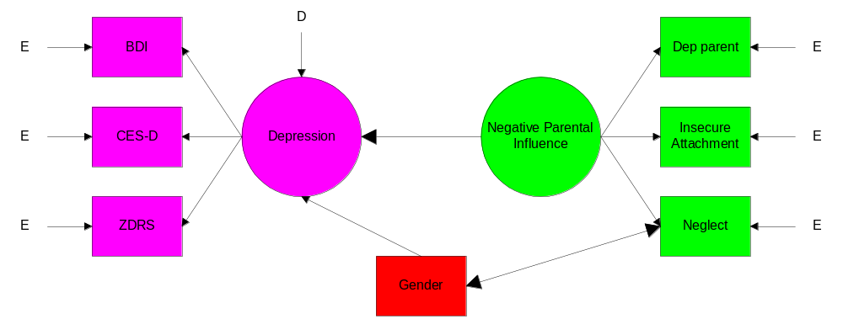
Path Diagram

Slide 10
SEM questions
Does the model produce an estimated population covariance matrix that “fits” the sample data?
  SEM calculates many indices of fit; close fit, absolute fit, etc.
Which model best fits the data?
What is the percent of variance in the variables explained by the factors?
What is the reliability of the indicators?
What are the parameter estimates from the model?

Slide 11
SEM questions
Are there any indirect or mediating effects in the model?
Are there group differences?
  Multigroup models
Can change in the variance (or mean) be tracked over time?
  Growth Curve or Latent Growth Curve Analysis

Slide 12
SEM questions
Can a model be estimated with individual and group level components?
  Multilevel Models
Can latent categorical variables be estimated?
  Mixture models
Can a latent group membership be estimated from continuous and discrete variables?
  Latent Class Analysis

Slide 13
SEM questions
Can we predict the rate at which people will drop out of a study or end treatment?
  Discrete-time survival mixture analysis
Can these techniques be combined into a huge mess?
  Multiple group multilevel growth curve latent class analysis???????

Slide 14
SEM limitations
SEM is a confirmatory approach
  You need to have established theory about the relationships
  Cannot be used to explore possible relationships when you have more than a handful of variables
  Exploratory methods (e.g. model modification) can be used on top of the original theory
  SEM is not causal; experimental design = cause

Slide 15
SEM limitations
SEM is often thought of as strictly correlational but can be used (like regression) with experimental data if you know how to use it.
  Mediation and manipulation can be tested
SEM is by far a very fancy technique but this does not make up for a bad experiment and the data can only be generalized to the population at hand

Slide 16
SEM limitations
Biggest limitation is sample size
  It needs to be large to get stable estimates of the covariances/correlations
  200 subjects for small to medium sized model
  A minimum of 10 subjects per estimated parameter
  Also affected by effect size and required power

Slide 17
SEM limitations
Missing data
  Can be dealt with in the typical ways (e.g. regression, EM algorithm, etc.) through SPSS and data screening
  Most SEM programs will estimate missing data and run the model simultaneously
Multivariate Normality and no outliers
  Screen for univariate and multivariate outliers
  SEM programs have tests for multi-normality
  SEM programs have corrected estimators when there’s a violation

Slide 18
SEM limitations
Linearity
No multicollinearity/singularity
Residuals Covariances (R minus reproduced R)
  Should be small
  Centered around zero
  Symmetric distribution of errors
  If asymmetric than some covariances are being estimated better than others

